Slide 1
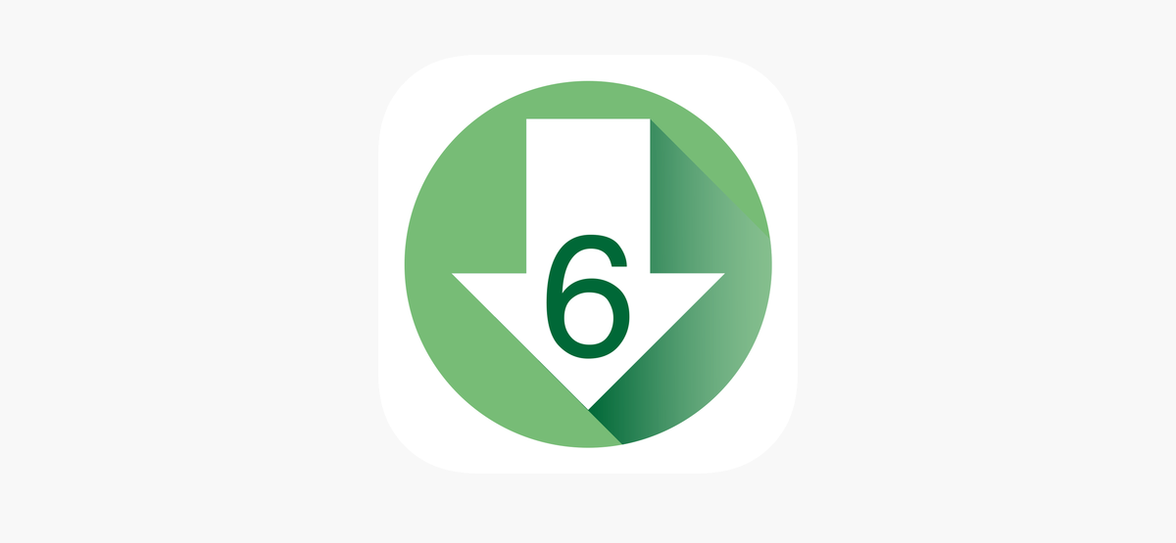
Lower6 APP
HOW DOES IT WORK?
HOW DOES IT WORK?

Slide 2
Topics
1) How to prepare a low glycemic indexed meal.(RECIPE)
2) How to purchase already prepared low glycemic indexed foods in your local area.
3) How can you expand your choices of healthy tasting foods.
4) How to look up a food manufacturer and the low glycemic foods they offer.

Slide 3
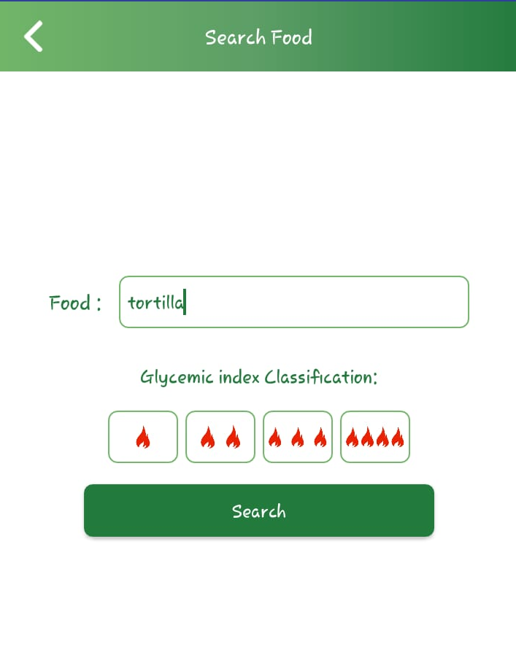
How to prepare a low glycemic indexed meal. (RECIPES)
1. Enter “Tortilla” in the search window
2.Click the search button

Slide 4
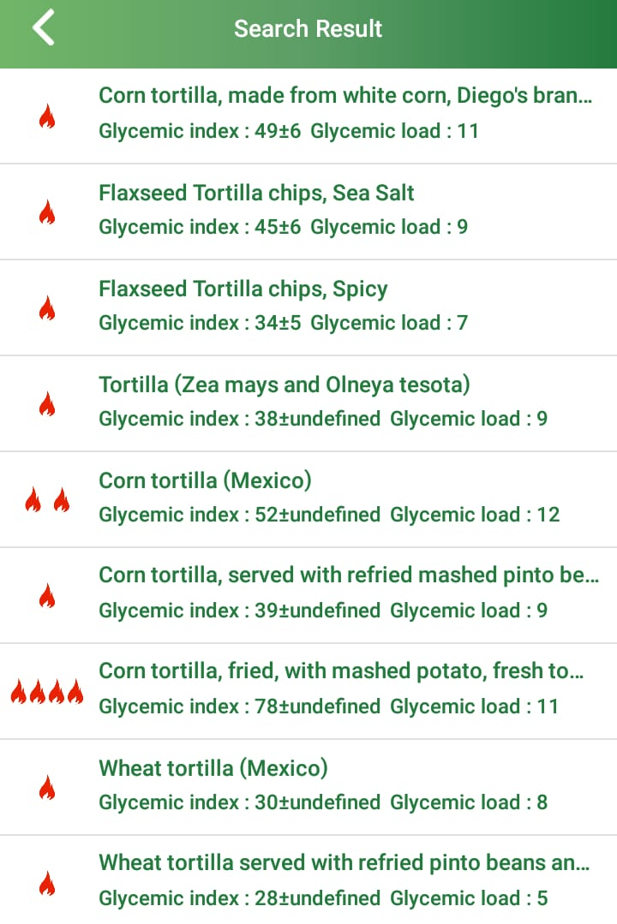
The results for TORTILLAS are grouped by SIMILAR FLAVOR and GLYCEMIC INDEX are displayed. (FLAMES)
If you would like to eat a CORN FLAVORED tortilla that is LOW glycemic index then click on the box and discover the information.

Slide 5
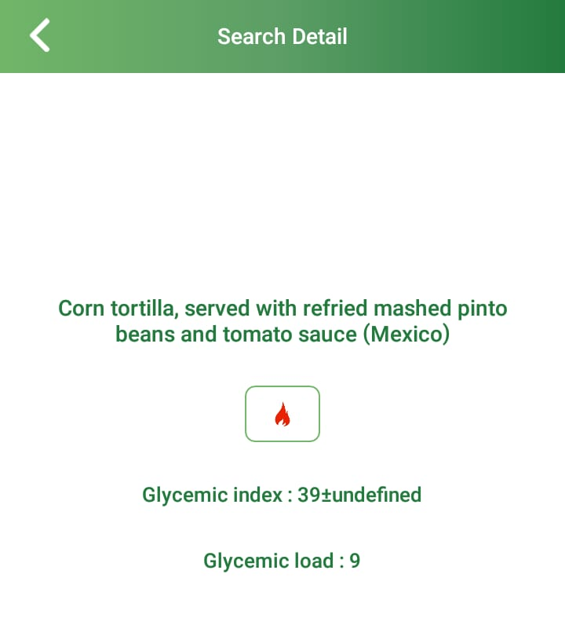
One Flame Recipe (No food Manufacturer listed)
In this case the app displays a RECIPIE because no food manufactrer is listed. Eat a “corn tortilla, served with refried mashed pinto beans and toato sauce.” (Low glycemic index)

Slide 6
Why is a Tortilla with the same FLAVOR have a higher Glycemic Index? (4 flames)
Click on the box and find out the informaton.

Slide 7
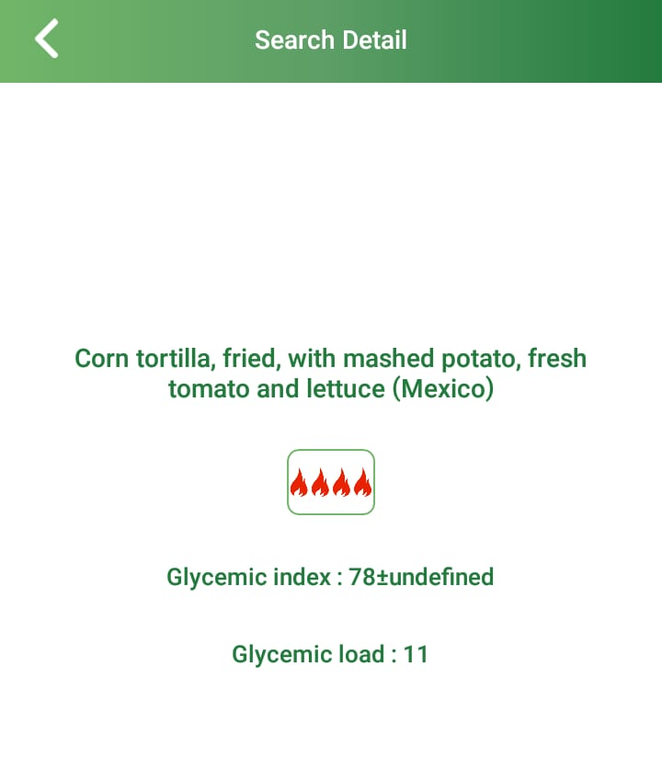
The results for TORTILLAS are grouped by SIMILAR FLAVOR and GLYCEMIC INDEX are displayed. (FLAMES)
If we eat a “corn tortilla, FRIED, with mashed potato, fresh tomato and lettuce” since there is no manufacturer listed this is a recipie which shows that when we FRY the corn flavored tortilla the glycemic index increases.

Slide 8
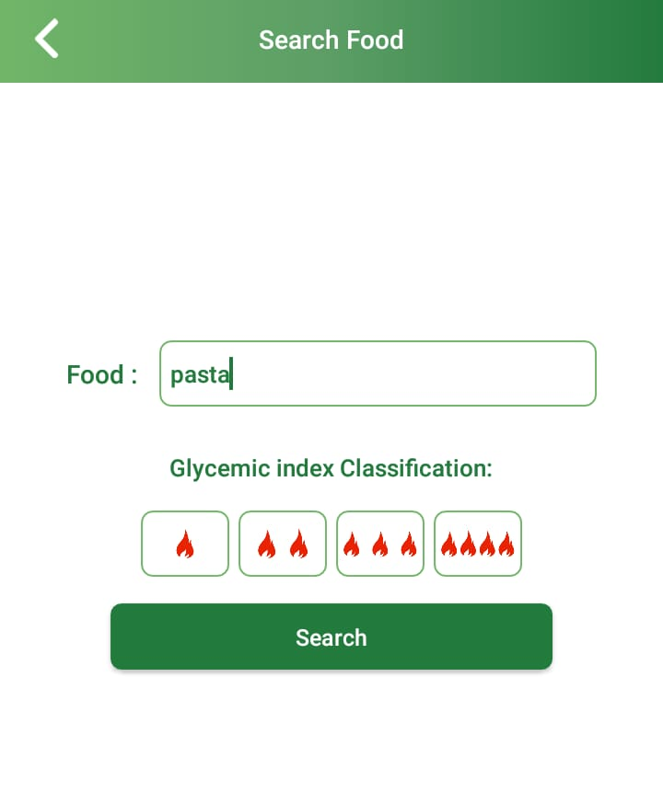
How to purchase already prepared low glycemic indexed foods in your local area.
1.Enter “Pasta” in the search window.
2.Click the search button

Slide 9
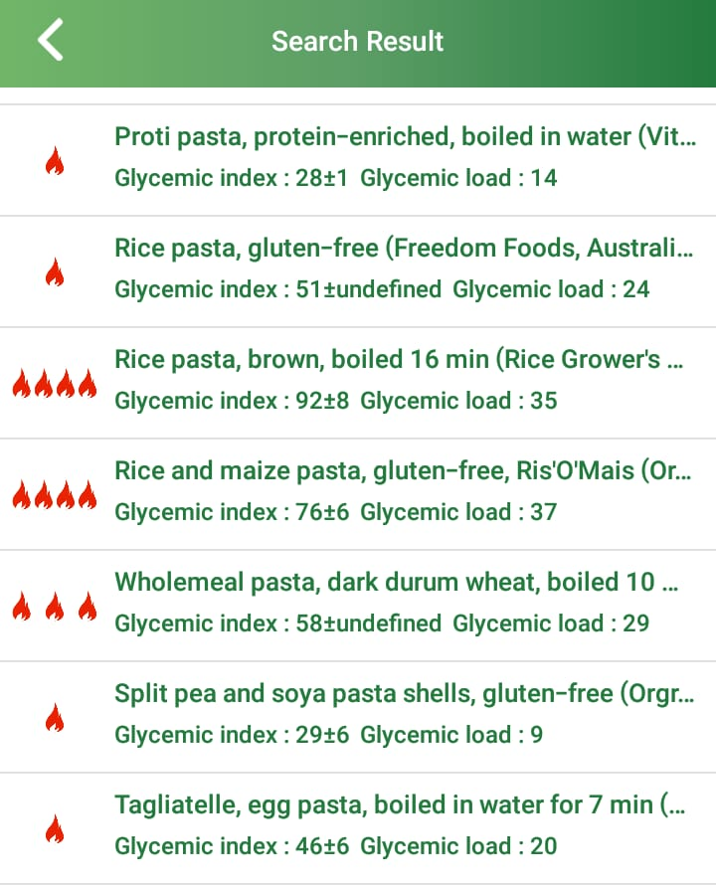
The app suggest that this is not a RECIPE but a FOOD FOR PURCHASE. (Freedom Foods is the MANUFACTURER)
Click on the box listing rice flavored pasta, low glycemic indexed meal. (1 flame)

Slide 10
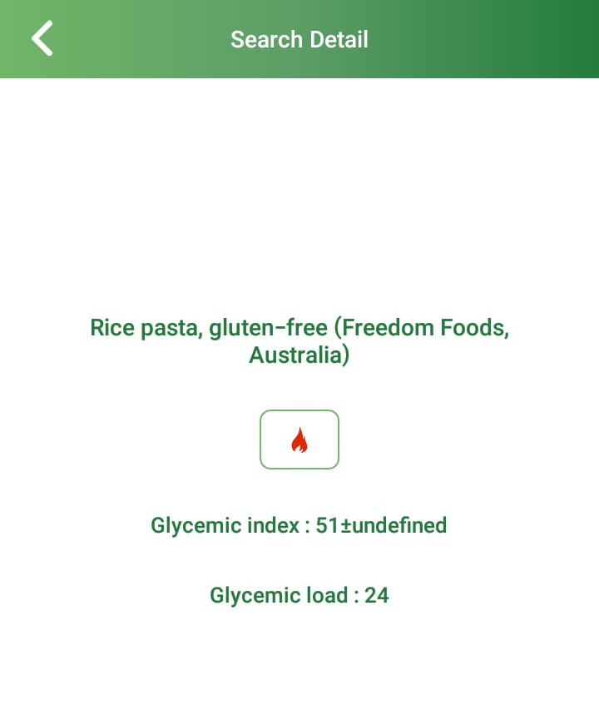
The app suggest that this is not a RECIPE but a FOOD FOR PURCHASE. (Freedom Foods is the MANUFACTURER)
Food for purchase

Slide 11
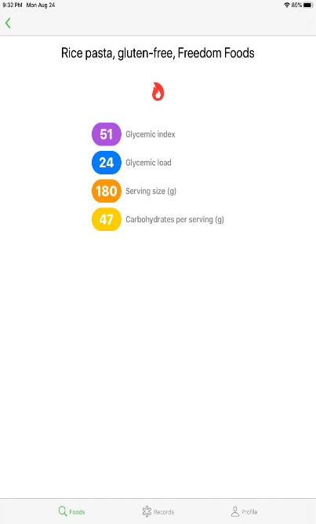
I can go to any internet search engine and type in the following;
Where can I find Rice Flavored Pasta, gluten free made by FREEDOM FOODS…

Slide 12
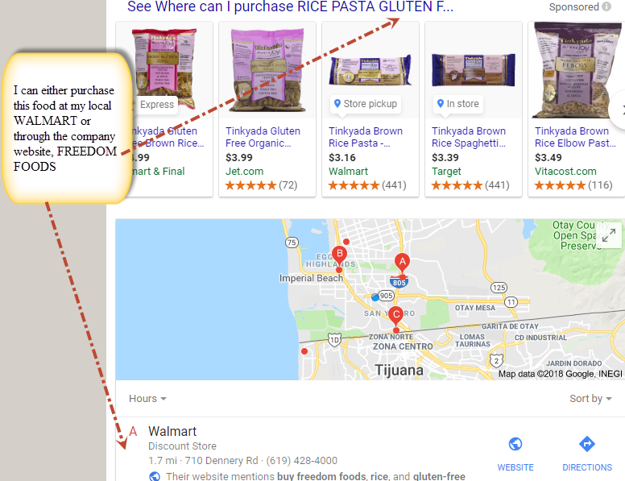
Or, where can I purchase

Slide 13
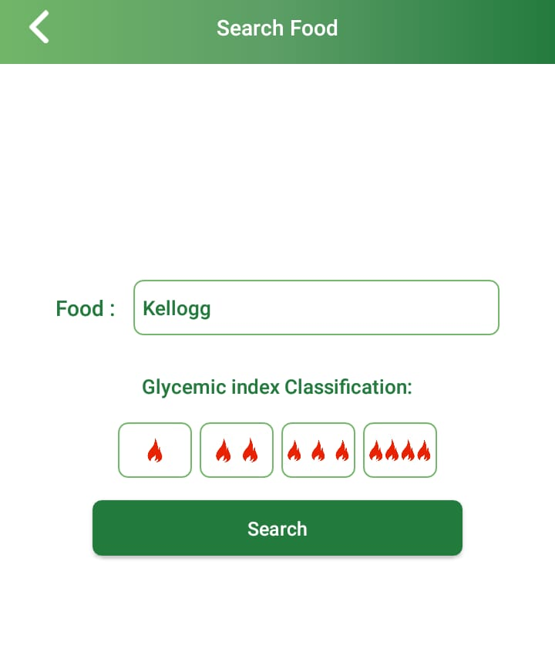
Lets say we want to look up foods manufactured by KELLOGG.
Just enter the name of the manufacturer
Click Search

Slide 14
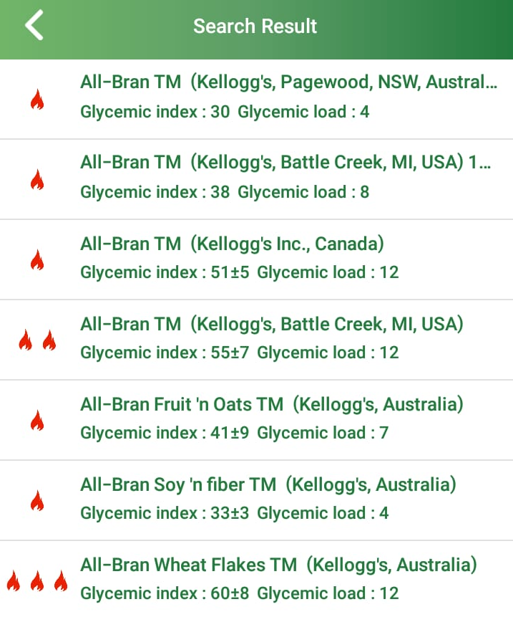
The app displays the flavor and glycemic index of foods produced by KELLOGG

Slide 15
How can you expand your choices of healthy tasting foods?
Lets say I did not enjoy the flavor of any 1 flame food, very low glycemic index pasta suggested by the APP even though I tried different flavors in that glycemic index range.
You have the option of entering a food and clicking on 2 flames or 3 flames to find other options.
Remember the goal is not FORCING you to eat certain foods but giving you the FREEDOM to find good tasting healthy food which YOU ENJOY EATING.

Slide 16
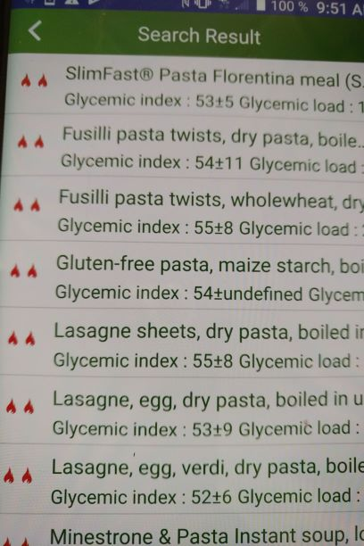
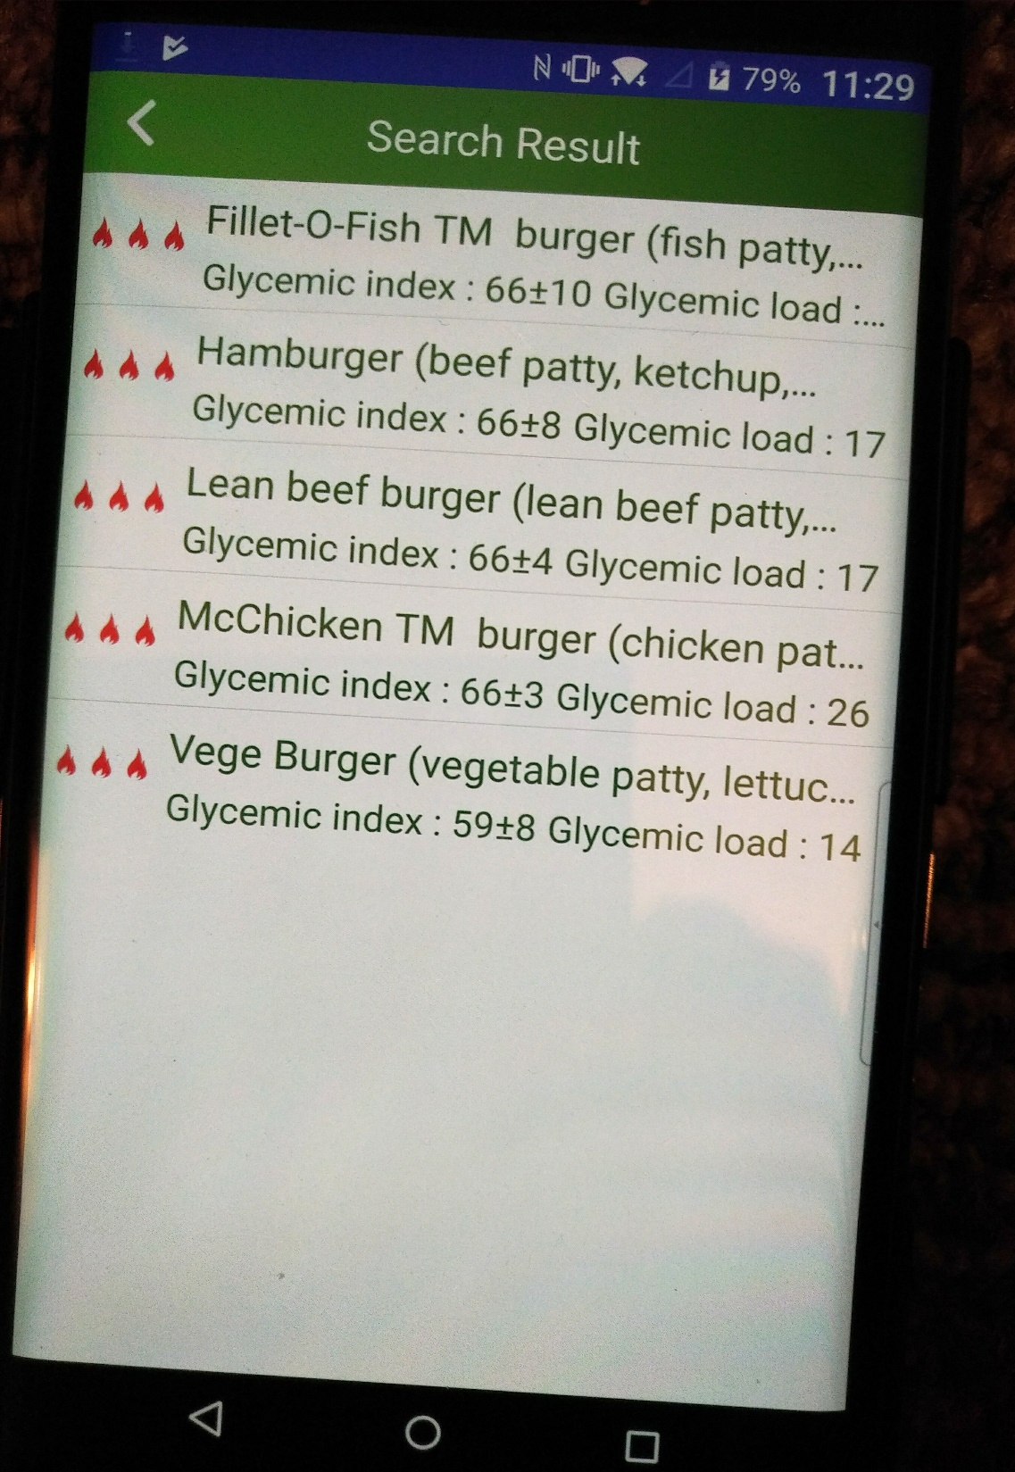

Slide 17
With the Lower 6 phone app your ADDITIONAL PHARMACY and NEW MEDICATION now become………….

Slide 18
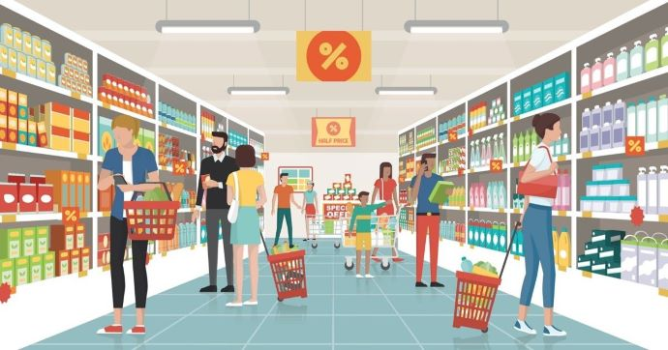
Your GROCERY STORE and FOOD

Slide 19
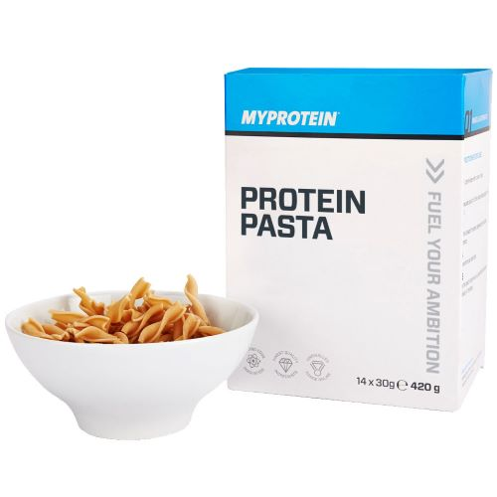
PATIENTS are not always COMPLIANT with TAKING MEDICATIONS but PEOPLE are always COMPLIANT with EATING FOOD. www.lower6app.com

